Slide 1
End to End Testing

Slide 2
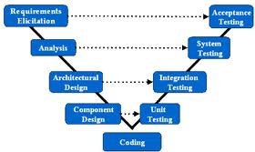
Overview of Testing Types

Slide 3
End to End Testing
End to End testing comes in two flavors
System Testing – IEEE 829 Definition
3.1.37 system testing: Testing conducted on a complete, integrated system to evaluate the system’s compliance with its specified requirements.
Acceptance Testing – IEEE 829 Definition
3.1.1 acceptance testing: (A) Testing conducted to establish whether a system satisfies its acceptance criteria and to enable the customer to determine whether to accept the system. (B) Formal testing conducted to enable a user, customer, or other authorized entity to determine whether to accept a system or component.
Acceptance testing is often called User Acceptance Testing or UAT

Slide 4
System Testing
Who
The technical team (devs or testers)
When
At code complete
What
Use case based
Agile teams can use the “acceptance criteria” from the User Stories
Not exhaustive from a coverage perspective
Can include many different dimensions
Performance
Stress
Security
Reliability (fail-over)
Where
Preferably on “production” hardware
How
Black box
Based on Requirements/Specifications

Slide 5
Acceptance Test
The same as System Test except for the “who”
The user or user representative writes and performs the tests as opposed to the techies
Users often need coaching from the technical team on writing the tests
But the user should determine the outcome of the tests and record all defects discovered

